Slide 1



EXCELSSIOR EDUCATION SOCIETY’S K. C. COLLEGE OF ENGINEERING AND MANAGEMENT STUDIES AND RESEARCH Department Of Information Technology (Affiliated to the University of Mumbai) Mith Bunder Road, Near Hume Pipe, Kopari, Thane(E)-400603

Slide 2
INTERNAL PRESENTATION
SEM-VI(2020-2021)

Slide 3
AUTOMATIC IRRIGARTION SYSTEM
Group members
1)Kaustubh Gawde 18
2)Harshal Boga 08
3)Ankit Dubey 16
Name of the Guide : Prof. Nikhat Shaikh

Slide 4
Index
Introduction
Scope
Problem Statement
System Requirements
System Features (For Simulator)
System Architecture (with Modules)
Screen Shots
Conclusion
References

Slide 5
INTRODUCTION
Indian agriculture is dependent on the monsoons which is not sufficient sources of water. The automatic irrigation system can provide water to farms according to their moisture and soil types.
Suitable water supply is required because of most of the farms depends upon the monsoon. In conventional system, the farmer has to follow a schedule for watering, which is different for different crops.
Too much watering causes diseases to plants and even they die out. To provides uniform and required level of water for both plain and sloppy areas and avoids the water overflow at the sloppy areas and considering the current labor shortage situation, the automated sensing system will be most appropriate.

Slide 6
The consumption of water increases day by day that may leads to the problem of water scarcity. The aim of the article is to develop an smart irrigation system which measures the moisture of the soil and turns on or off the water supply system.
Problem Statement

Slide 7
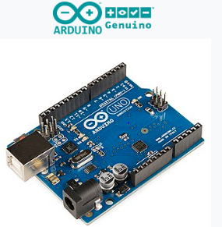
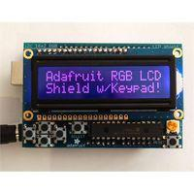
Arduino The Arduino Uno is a microcontroller board based on the ATmega328. It has 20 digital input/output pins (of which 6 can be used as PWM outputs and 6 can be used as analog inputs), a 16 MHz resonator, a USB connection, a power jack, an in-circuit system programming (ICSP) header, and a reset button LCD DISPLAY: RGB LCD Shield for Arduino Microcontroller Boards that only uses 2 I2C pins. This is a super slick way to add a display without all the wiring hassle. It uses the I2C pins at Analog 4 and Analog 5.
System Requirements

Slide 8
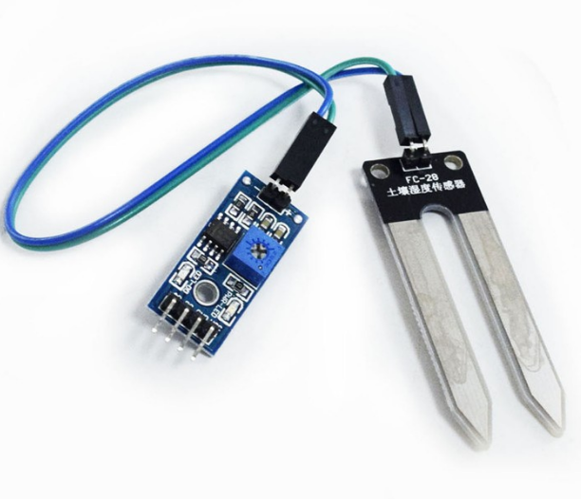
MOISTURE SENSOR : Soil moisture sensors measure the volumetric water content in soil. ... Another class of sensors measure another property of moisture in soils called water potential; these sensors are usually referred to as soil water potential sensors and include tensiometers and gypsum blocks.

Slide 9
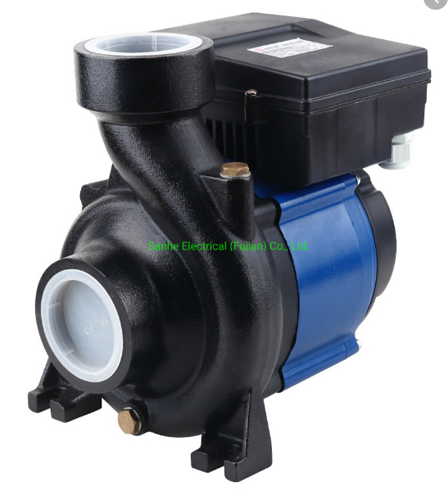
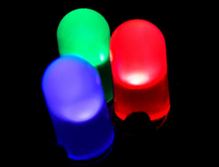
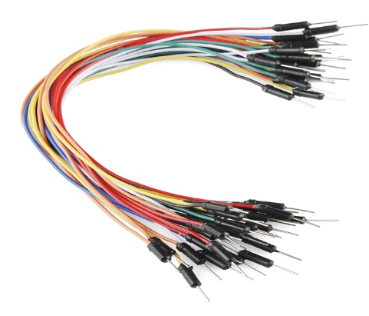
WATER PUMPS: Water pumps are machines for moving water, they play a fundamental part in agriculture as they move water from its source to the fields and crops. Water pumps can be used with many forms of irrigation, such as drip, sprinklers or with a hose. LED: A light-emitting diode (LED) is a semiconductor light source that emits light when current flows through it. The color of the light (corresponding to the energy of the photons) is determined by the energy required for electrons to cross the band gap of the semiconductor. CONNECTING WIRES : Connecting wires provide a medium to an electrical current so that they can travel from one point on a circuit to another.

Slide 10
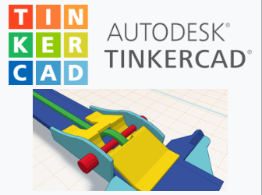
Tinkercad Tinkercad is a free, online 3D modeling program that runs in a web browser, known for its simplicity and ease of use

Slide 11
In this project, we are building an IoT based smart irrigation System using Arduino UNO, Moisture sensor, and LCD Display. It will automatically sprinkle the water to plants when the moisture value goes below a particular value. It will also send the moisture data to LCD display to keep track of the land condition. LCD Display will display whether Water Pump is on or off. This project uses a solenoid valve to supply the water to the plants. You can change the moisture value at which the solenoid valve should turn on according to your plant's requirement. Here we are using Arduino UNO which is a very popular for IoT based Projects.
Working:

Slide 12
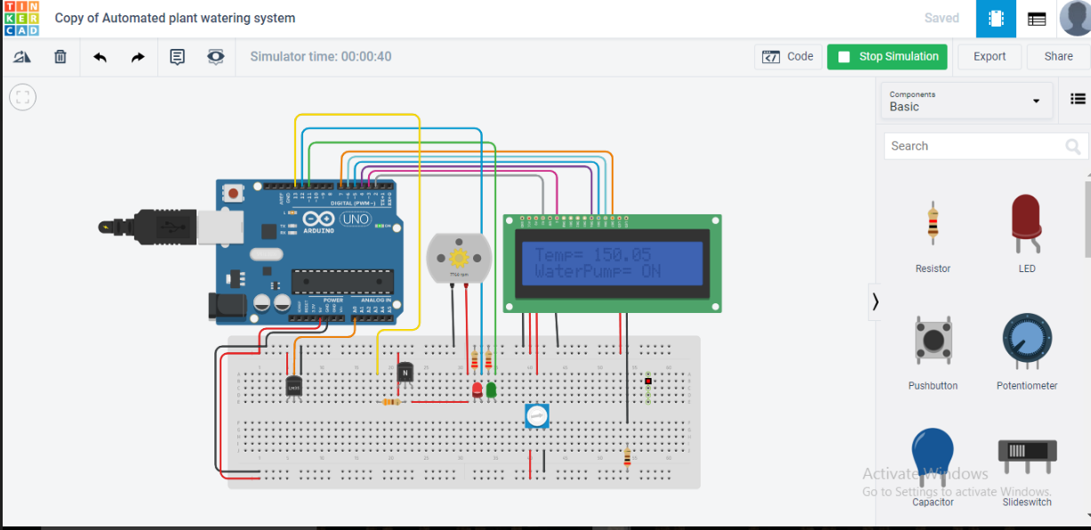
CIRCUIT DIAGRAM :

Slide 13
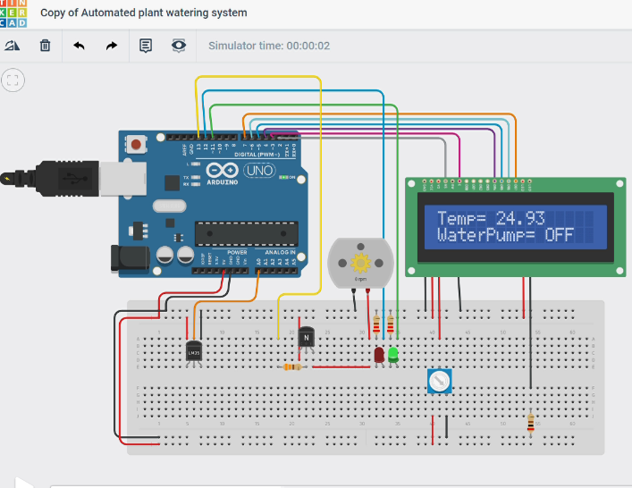
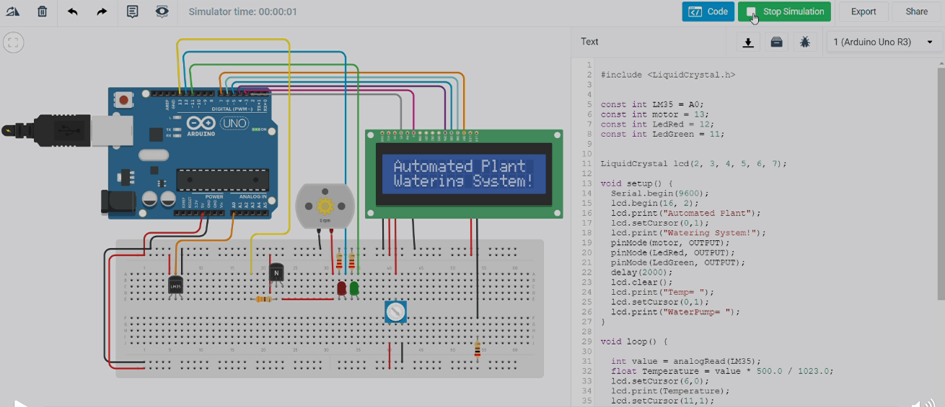
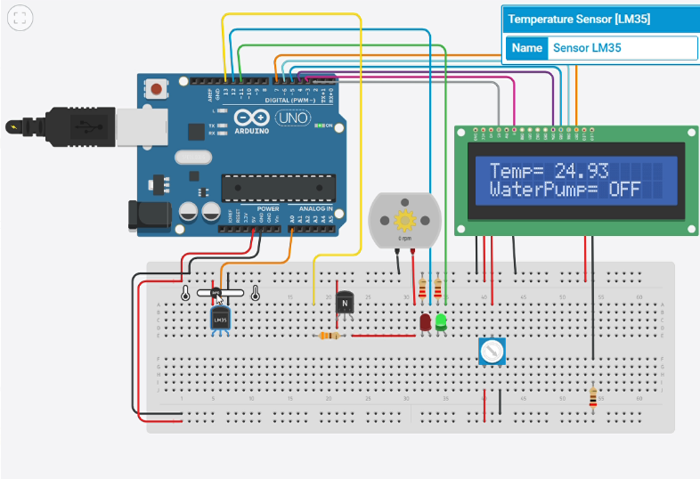
SCREENSHOTS OF OUR MINI PROJECT Automatic Irrigation System

Slide 14
CONCLUSION : 1.The smart irrigation system implemented is feasible and cost effective for optimizing water resources for agricultural production. 2.This irrigation system allows cultivation in places with water scarcity thereby improving sustainability. 3.The smart irrigation system developed proves that the use of water can be diminished for a given amount of fresh biomass production. Real time system for irrigation is based on GSM and zigbee module. The system is incredibly versatile and economical. 4.It doesn't need individuals on duty it is so easy and reliable.

Slide 15
REFRENCES • Design and Implementation of Automatic Plant Watering System by “Archana and Priya” presented at International Journal of Advanced Engineering and Global technology, vol-04, Issue-01, Jan-2016. Sensor Based Automated Irrigation System with IOT by “Karan Kansara and Vishal Zaweri,” presented at International Journal of Computer Science and Information Technologies, vol-06, 2015. C. Arun, K. Lakshmi Sudha “Agricultural Management using Wireless Sensor Networks – A Survey”2nd International Conference on Environment Science and Biotechnology IPCBEE vol.48 (2012) © (2012) IACSIT Press, Singapore 2012. Venkata Naga Rohit Gunturi, “Micro Controller Based Automatic Plant Irrigation System” International Journal of Advancements in Research and Technology, Volume 2, Issue-4, April-2013.

